Slide 1

PROJECT TITLE: Vision-Based Robotic System for Interactive Learning in University Labs SUPERVISOR: Mr Sokotela.
STUDENT DETAILS: Group Project
NAME: Kima, Praise, Rene, Kondwani
SIN:
PROGRAM: Mechatronics 4

Slide 2
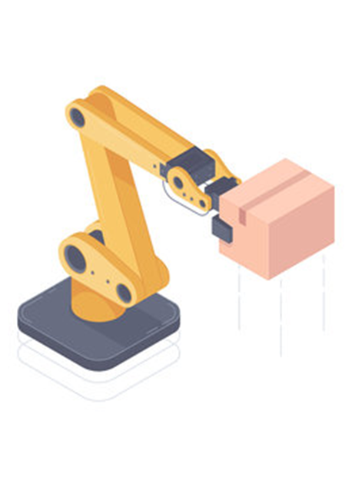
1.0 Introduction/Synopsis/Background
The field of robotics is becoming increasingly important in many industries. There is a growing need for skilled professionals who are well-versed in the field.
Many universities around the world have recognized this need and have introduced robotics courses to their curriculum.
Robotics can be a challenging task, and requires a significant amount of theoretical and practical knowledge.
To facilitate the learning process, many universities are now using actual robots as learning aids in robotics courses.
Robots are designed to provide students with a hands-on learning experience, allowing them to interact with the robot and gain practical experience in programming, controlling, and operating it.

Slide 3
1.1 Problem Statement
Background: In Zambia, there is a need for affordable and accessible educational tools that can be used to teach students about advanced technologies such as robotics.
However, the high cost and limited availability of imported robotics kits make it difficult for schools to provide hands-on learning opportunities to students. Additionally, many students do not have access to the latest technologies due to the country's limited manufacturing capabilities.
The solution provided: To design and develop an affordable and locally manufactured educational robot that can be used to teach robotics and programming to students in Zambia..

Slide 4
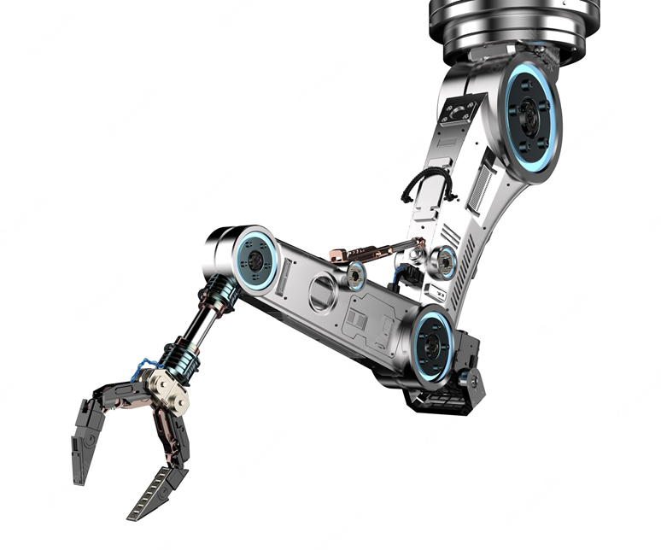
1.2 Motivation/Justification
Research suggests that students tend to learn better with practical, hands-on learning experiences as compared to purely textual-based learning. This hands-on learning allows students to engage with the material in a more active and immersive thus better understand and retain the information.
Practical learning can help students develop important skills such as problem-solving, critical thinking, and collaboration, often difficult to develop through textual-based learning alone.
A combination of both practical and textual-based learning can be an effective approach to education

Slide 5
1.3 Aim
The aim of the project "Vision-Based Robotic System for Interactive Learning in University Labs" is to provide an innovative and interactive learning tool for university students to enhance their understanding and practical experience in the field of robotics and automation.
The robotic arm would be designed to allow students to visualize and interact with complex concepts, and gain hands-on experience in programming, controlling, and operating a robotic arm using computer vision technology.
The project aims to improve the quality of education in the field of robotics and automation, and prepare students for future careers in related industries.

Slide 6
1.4 Objectives
Designing and building a vision-based robotic arm that can be used as a learning aid for mechatronics and robotics students in university labs.
Creating a user-friendly interface and control system that enables students to easily operate the robotic arm and perform tasks.
Developing a curriculum and instructional materials that integrate the robotic arm into the learning process, and enable students to acquire knowledge and skills related to robotics and automation.
Conducting research on the effectiveness of using the robotic arm as a learning aid, and identifying best practices for incorporating robotics into mechatronics and engineering education.
Establishing partnerships with industry and other organizations to explore potential applications for the robotic arm, and to provide students with opportunities to gain hands-on experience with real-world problems.
Promoting interest and awareness of robotics and mechatronics education among students, educators, and the wider community.

Slide 7
1.5 Project Scope
System is designed to be most effective for:
Conducting a thorough analysis of existing educational robotics platforms and identifying their limitations and drawbacks.
Defining the specific requirements of the educational robot, including hardware, software, and usability aspects.
Designing and prototyping the educational robot based on the defined requirements and using locally available materials and components.
Evaluating the effectiveness of the educational robot in teaching robotics and programming concepts to students through a series of field tests and surveys.
Refining and improving the design based on the feedback from the field tests and surveys.
Documenting the final design and making it available to schools and educators throughout Zambia.

Slide 8
2.0 Literature Review
"Teaching Robotics to Undergraduates Using Hands-On Learning with a Humanoid Robot" by O. Erol, M. Cakmak, and M. Dogar. In this study, the authors describe a hands-on learning approach for teaching robotics to undergraduate students using a humanoid robot. The results show that the hands-on approach improved student engagement, understanding, and motivation.
"Robotics in Education: A Review" by A. Alimisis. This review examines the impact of robotics on education and provides evidence for the effectiveness of using robots in the classroom. The author concludes that robotics can enhance student learning and engagement, and can help students develop skills in problem-solving, critical thinking, and teamwork.
"Assessing the Effectiveness of Robotic Platforms for Teaching Robotics Concepts in Undergraduate Engineering Programs" by M. K. Habib and J. C. Magnes. This study evaluates the effectiveness of using robotic platforms for teaching robotics concepts to undergraduate students. The results show that the use of robotic platforms improved student engagement, motivation, and understanding of robotics concepts.

Slide 9
2.0 Literature Review
"Teaching Robotics in Schools: The Impact on Students' STEM Learning" by Peter I. Ndumu, David R. Hall, and Ioan D. Marinescu. Journal of Educational Technology & Society, 2017.
This study examines the impact of teaching robotics on students' STEM (Science, Technology, Engineering, and Mathematics) learning in schools. The authors conducted a survey of over 1000 students and found that robotics instruction positively impacted students' interest in STEM subjects, as well as their confidence in their ability to succeed in these subjects. The study also highlights the importance of effective teacher training and support in implementing robotics programs in schools.
"Effectiveness of Robotics-Based STEM Curriculum for Elementary School Students" by Rebecca A. Miles and Heather M. Fitzpatrick. Journal of STEM Education, 2018.
In this study, the authors examine the effectiveness of a robotics-based STEM curriculum for elementary school students. The curriculum focused on using robotics to teach coding and engineering concepts, and the authors found that students who participated in the curriculum showed significant gains in their coding and engineering knowledge, as well as their problem-solving and teamwork skills. The study suggests that robotics can be an effective way to engage elementary school students in STEM learning.

Slide 10
2.0 Literature Review
"Robotics and Its Educational Impact on Students with Learning Disabilities" by Gayle B. Prybutok, Nancy L. Kress, and Christopher L. Butler. International Journal of Social Robotics, 2019.
This study explores the educational impact of robotics on students with learning disabilities. The authors conducted a survey of 51 students with learning disabilities who participated in a robotics program, and found that the program had a positive impact on the students' social, emotional, and academic development. The study suggests that robotics can be an effective way to engage and support students with learning disabilities.

Slide 11
3.0 Methodology
Conceptualization: The first stage in creating a learning model robot . Involves identifying the problem that the robot is intended to solve and the tasks it is supposed to perform.
Design: This stage involves creating 2D and 3D sketches of the robot, determining the robot's size, shape, and materials, and selecting the appropriate sensors, actuators, and control systems.
Prototyping: A physical prototype of the robot is created to test the robot's design and functionality. The prototype is then tested to determine whether it meets the design requirements.
Programming: The robot's control system needs to be programmed. This involves developing software that controls the robot's movements, sensors, and responses to external stimuli.
Testing: The robot is tested to determine whether it meets the design and functional requirements. Testing the robot's movements, sensors, and control systems
Refining: Based on the results of the testing stage, the robot's design may need to be refined to improve performance and functionality.
Production: Once tested and validated, the robot can be produced -manufacturing the robot using the
Deployment: In this final stage, the robot is deployed in the learning environment. This stage involves training the robot's control system to recognize and respond to various stimuli and monitoring the robot's performance in a real-world setting.

Slide 12

4.0 Project Plan - Gantt Chart

Slide 13
5.0 Budget Estimate
Material budget
APPROXIMATED BUDGET (BILL OF QUANTITY)
NOTE
The components in RED will be locally sourced
Miscellaneous amount is a general ledger account that may contain a large number of minor expenses.
# | Component description | Part number/specification | Quantity | Unit price | Total price
 | ROBOTIC ARM PARTS
 | Servo motor | Tower pro SG 90 5v | 1 | K100 | K100
 | Servo motors | Tower pro MG 995 6v | 4 | K250 | K1000
 | Robotic arm frame | 3D printed(plastic) | 1 | --------
 | CONVERYOR BELT PARTS
 | DC motor | 25A370 6v | 1 | K150 | K150
 | DC motor driver | L298N | 1 | K100 | K100
 | Deep grove ball bearings | 1.5*4*2mm | 2 | K75 | K150
 | Belt | Leather | 1 | -------
 | Pulleys | 3D printed(plastic) | 2 | -------
 | Gears | 3D printed(plastic) | 2 | -------
 | Shaft | 1m | 2 | -------
 | UNIVERSAL PARTS
 | Arduino mega | Mega 2560 r3 | 1 | K300 | K300
 | 1080 web camera | Wide angle USB camera | 1 | K350 | K350
 | Power supply |  | 1 | K150 | K150
 | IR sensor |  | 1 | K80 | K80
 | Connecting wire | 10m | 1 | K100 | K100
 | M3 nuts and bots |  | 50 | K2 | K100
 | PVC sheets | plastic | 1 | -------
 | Wood | Flat board |  | -------
 | Laptop | Already available |  | -------
Miscellaneous |  |  |  |  | K774
TOTAL |  |  |  |  | K3354

Slide 14
END

